Slide 1
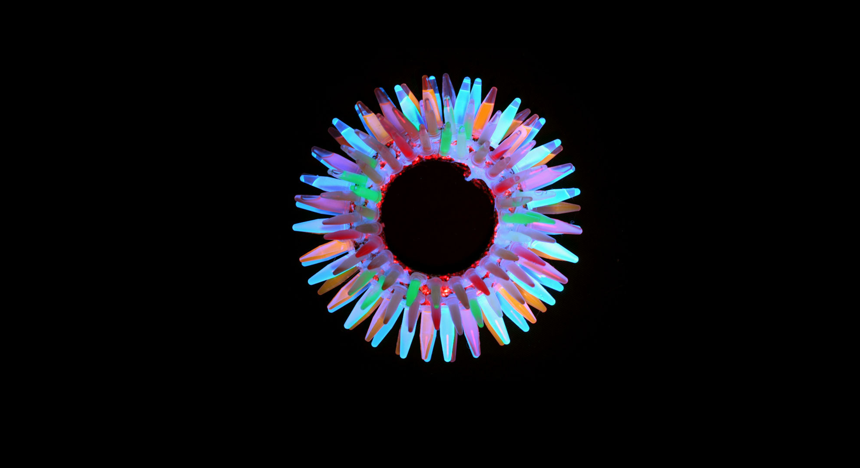
Green Fluorescent Proteins
From Structure to Function
Presented by Chengjie Qiu
Yueyan Wu
Yuejian Mo
Notes:
exhibits bright green fluorescence when exposed to light in the blue to ultraviolet range.

Slide 2
Outline
Introduction
Structure analysis of Aequorea victoria GFP
Underlying mechanism and further modifications of the fluorescence
From new functions to new applications

Slide 3
History
A timeline → some notable points (figure from 2010 review)
classification: PDB entry (from avGFP to GFP variants in other species) (table from 2011 systematic review)

Slide 4
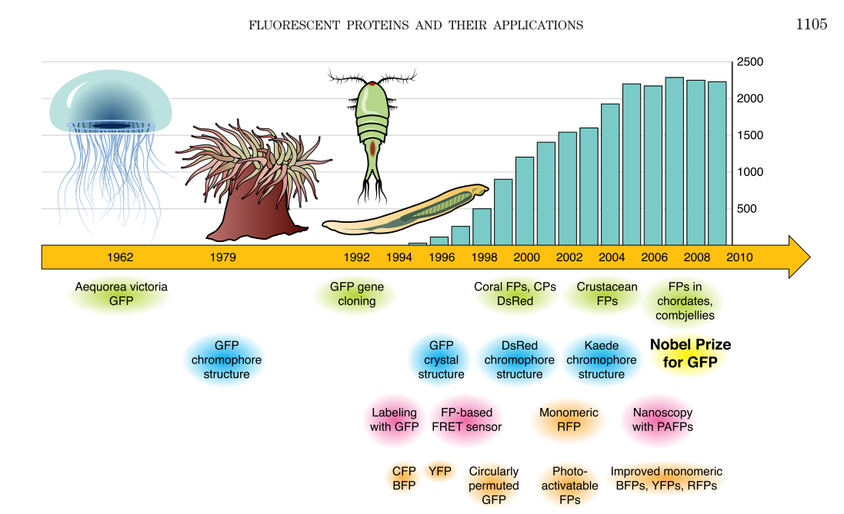
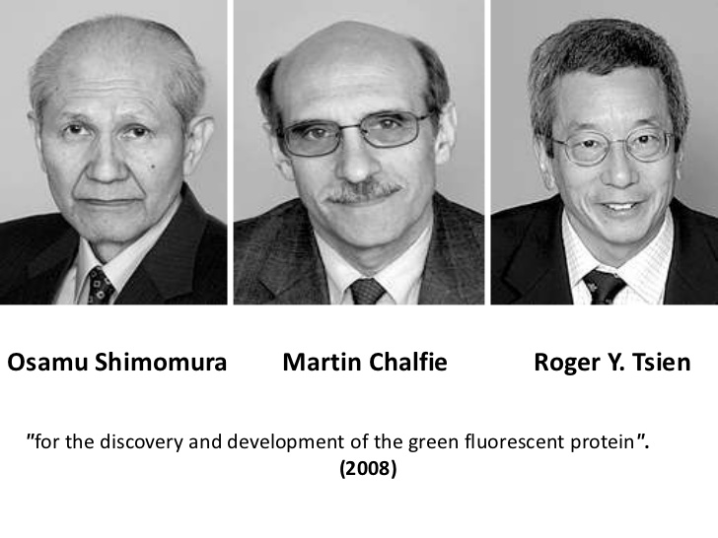
Timeline - the development of fluorescent proteins and their applications
(Chudakov, Matz, Lukyanov, & Lukyanov, 2010)
Notes:
Nobel prize in chemistry
下村修首次从Aequorea victoria中分离出GFP。他发现该蛋白在紫外线下会发出明亮的绿光。 Martin Chalfie证明了GFP作为多种生物学现象的发光遗传标记的价值。在最初的一项实验中，他用GFP使秀丽隐杆线虫的6个单独细胞有了颜色。
钱永健的主要贡献在于让人们理解了GFP发出荧光的机制。同时，他拓展出绿色之外的可用于标记的其他颜色，从而使科学家能够对各种蛋白和细胞施以不同的色彩。这一切，令在同一时间跟踪多个不同的生物学过程成为现实。
GFP-like proteins share similar structure, typical and simple enough to be a domain
harmless to most organisms, multiple variants, mighty tool as a reporting protein
4

Slide 5
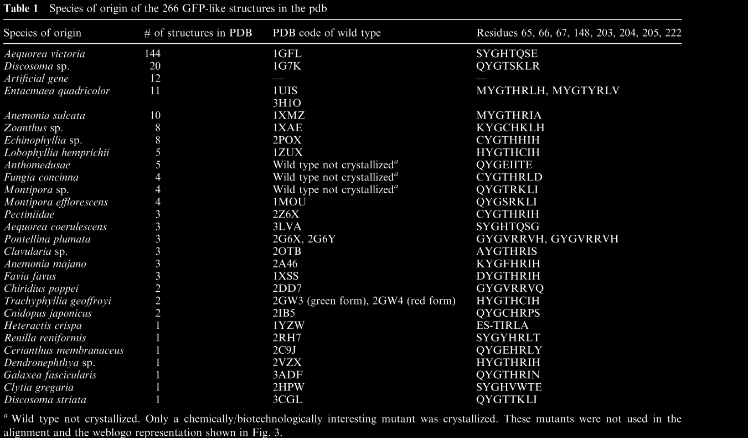
Diversity of GFP-like structure
(Ong et al., 2011)
Notes:
Over 150 distinct GFP-like proteins are currently known.
marine organisms
all but one of the non-green colors arose from an ancestor with a canonical green chromophore
5

Slide 6
Structure overview
Conponents:11 beta-sheets → barrier + fluorophore (a systematic diagram) + dimer
Why this compact structure (a PyMOL figure)
How to illuminate:
nature of fluorophore
features (excitation/emission wavelength)
mechanism of cyclization/oxygenation
photon transfer
conserved residues: lid + sheet + unknown
A brief summary of wtGFP structure (a video generated by PyMOL)

Slide 7
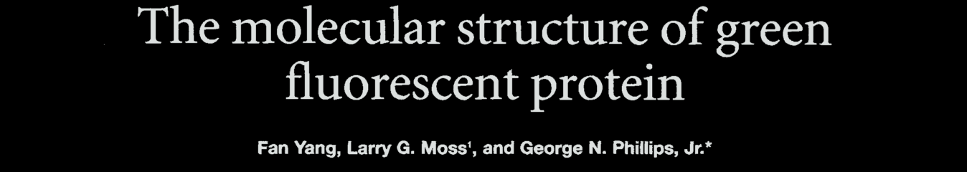
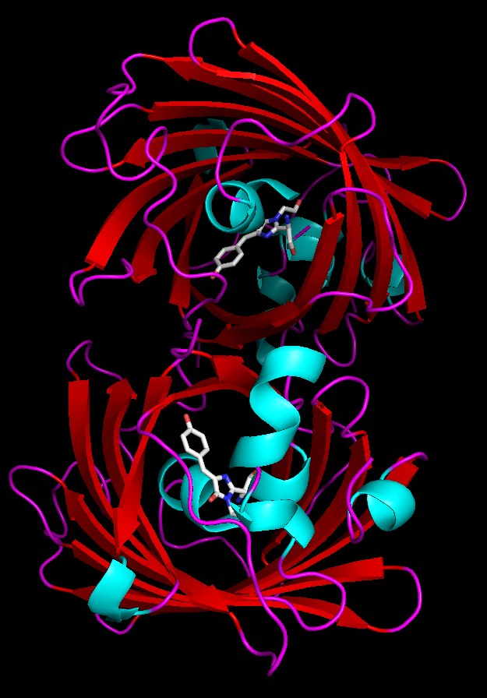
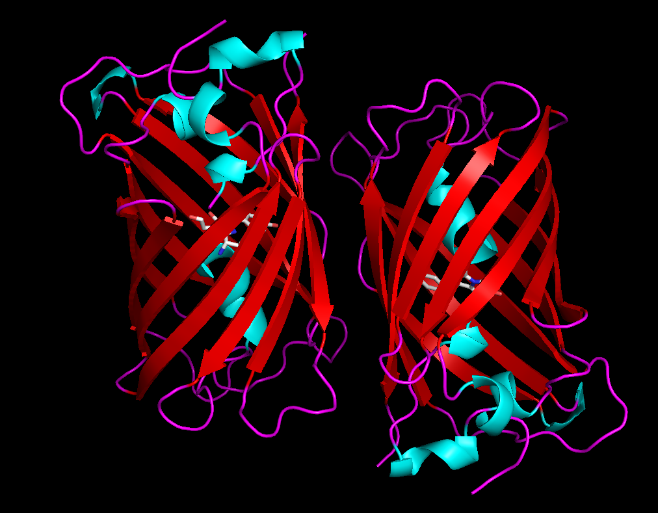
Overview of structure – wild type avGFP
Side view
Top view
Notes:
Fanyang illustrated the X-ray structrue of WT avGFP for the first time in 1996. present two views
Strands that cross in this sort of helical lattice around the outside, and then up the middle is an alpha helix that carries the chromophore
wtGFP and S65T GFP
in wtGFP, dimeric → hydrophobic patch → maybe bad when we need GFP to tag a particular protein → take A206K will destroy dimerization by electrostatic replusion
7

Slide 8
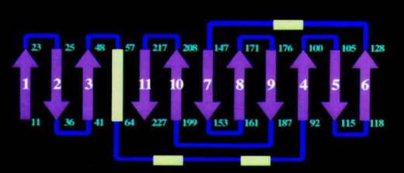
Overview of structure – wild type avGFP
Perfect Cylinder: 42Å long and 24Å in diameter;
11 strands of β-sheets + α-helices caps & running through the center (carrying the fluorophore);
In the form of dimer under nature conditions.
(Yang, Moss, Phillips, Phillips Jr., & Phillips, 1996)
Notes:
anti-paraelle Strands that cross in this sort of helical lattice around the outside, and then up the middle is an alpha helix that carries the chromophore
8

Slide 9
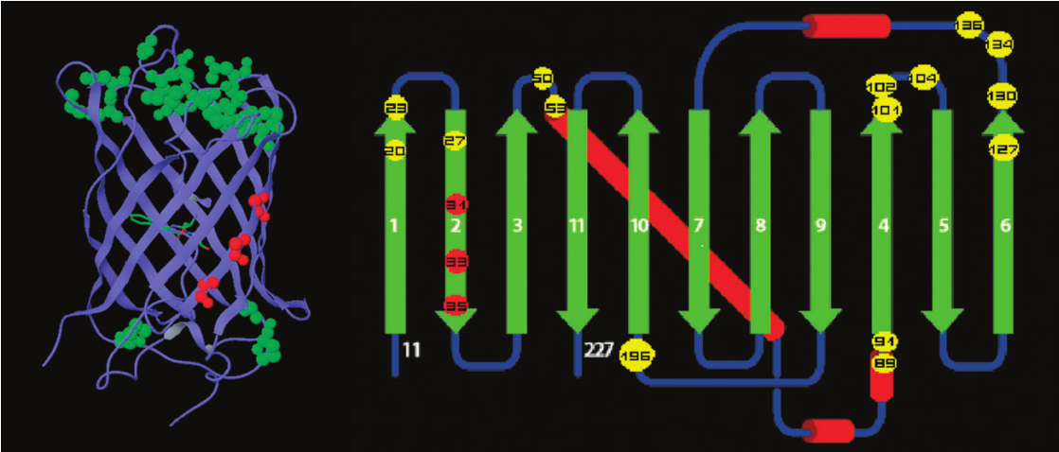
conserved “lid” residues
All highly conserved residues located in the lids are depicted as green CPK atoms (left) or yellow circles (right).
(Ong et al., 2011)
Notes:
most of the residues are located in the top helix and turn， forming a lid of the barrel
highly protected , water is polar, water collision can largely disturb the spectra of fluorophore
largely unknown
9

Slide 10
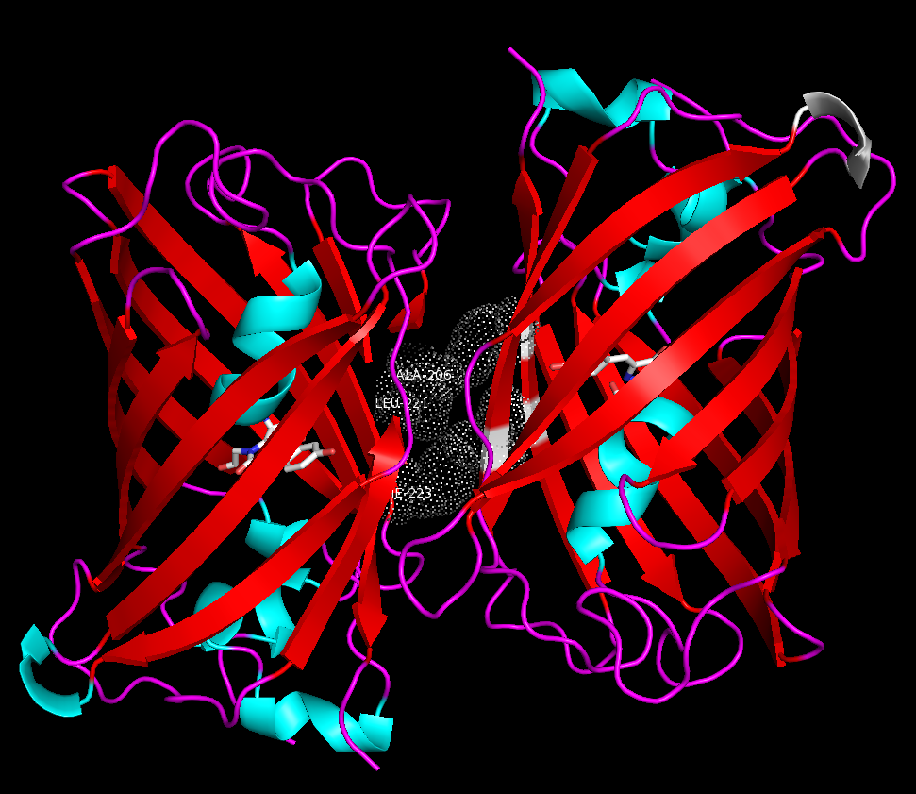
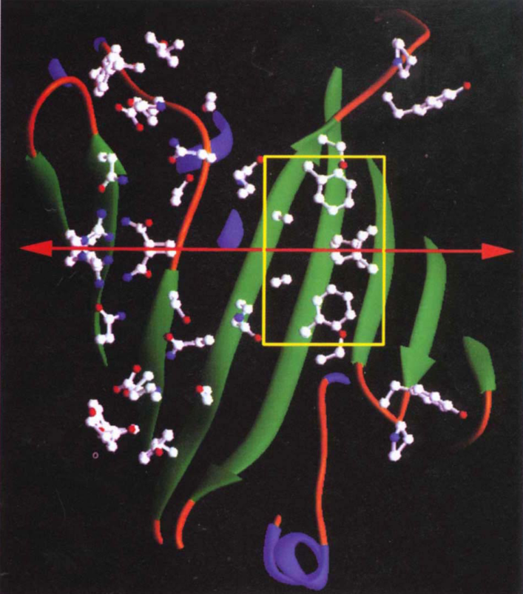
Dimerization of wtGFP
Side view
Interface : hydrophobic core and a wealth of hydrophilic residues
(Yang, Moss, Phillips, Phillips Jr., & Phillips, 1996)
Notes:
monomer is proved to emit fluo with a higher intensity
Also, dimer is hard to tag other proteins
dimer的结构基础 is a hydrophobic core made up of 3 hydrophobic residues. Wealth of 亲水group forms casual and complex interactions, making the dimerization especially salt-bridge-dependent
It seems that hydrophobic interactions play a leading role. If disturb even one hydrophobic interaction, the dimerization would be comprised.
in wtGFP, dimeric → hydrophobic patch → maybe bad when we need GFP to tag a particular protein → take A206K will destroy dimerization by electrostatic replusion
10

Slide 11
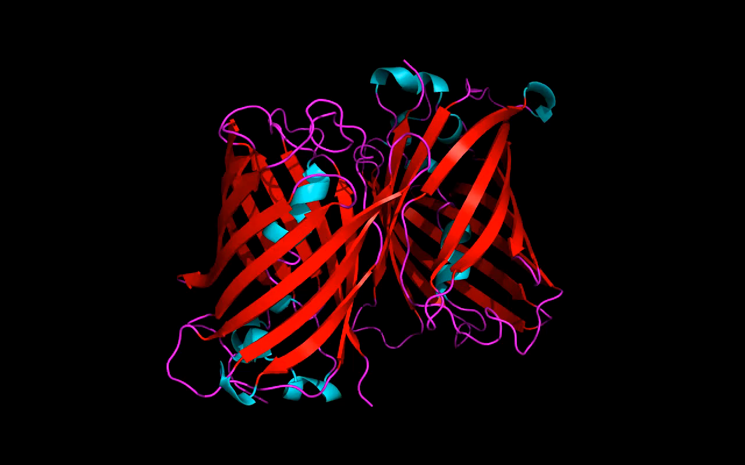
Dimerization of avGFP
Clip 1: Hydrophobic core in the interface, mutation of which could destroy the dimerization
Notes:
why Monomer Better than dimer
dimer的结构基础
11

Slide 12
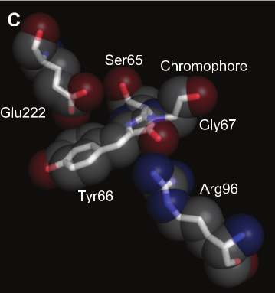
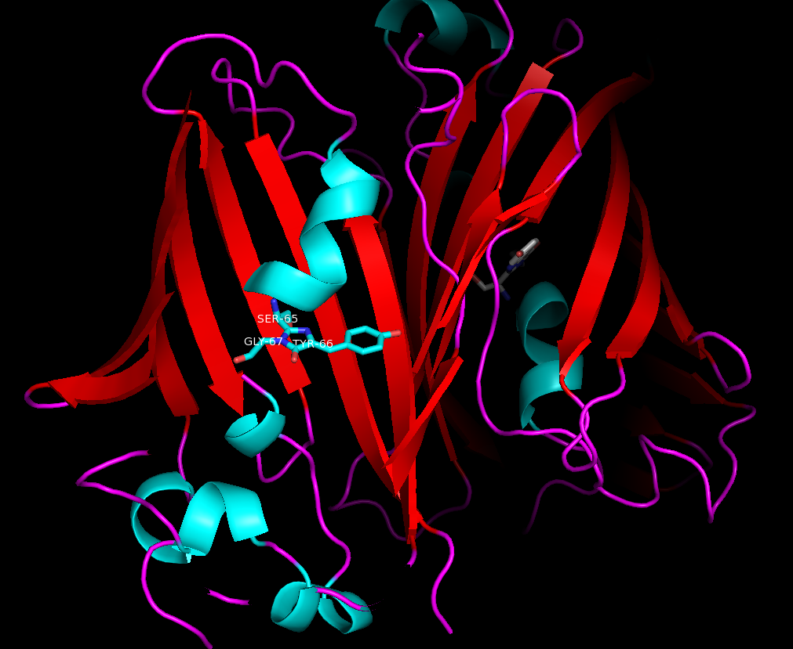
Fluorophore – a key structure responsible for fluorescence
The chromophore group is formed by a unique posttranslational modification of the three amino acid residues of the helix at positions 65–67 (Arg-Tyr-Gly).
(Chudakov, Matz, Lukyanov, & Lukyanov, 2010)
Notes:
67 is present in all FP
wtGFP and S65T GFP
66 also But not participate in cyclization, no known functions, nothing to do with the color
These reactions result in a two-ring structure representing a conjugated-system that is large, polarized, and planar enough to absorb and emit light within the visible range.
However, in most cases, the protonated GFP-like chromophores undergo the process called ESPT (exited state proton transfer): immediately after excitation, the chromophore loses one of its protons and becomes charged, thus dissipating a portion of the absorbed energy. Subsequently, it emits green fluorescence with an emission spectrum essentially identical to that of the initially charged form
12

Slide 13
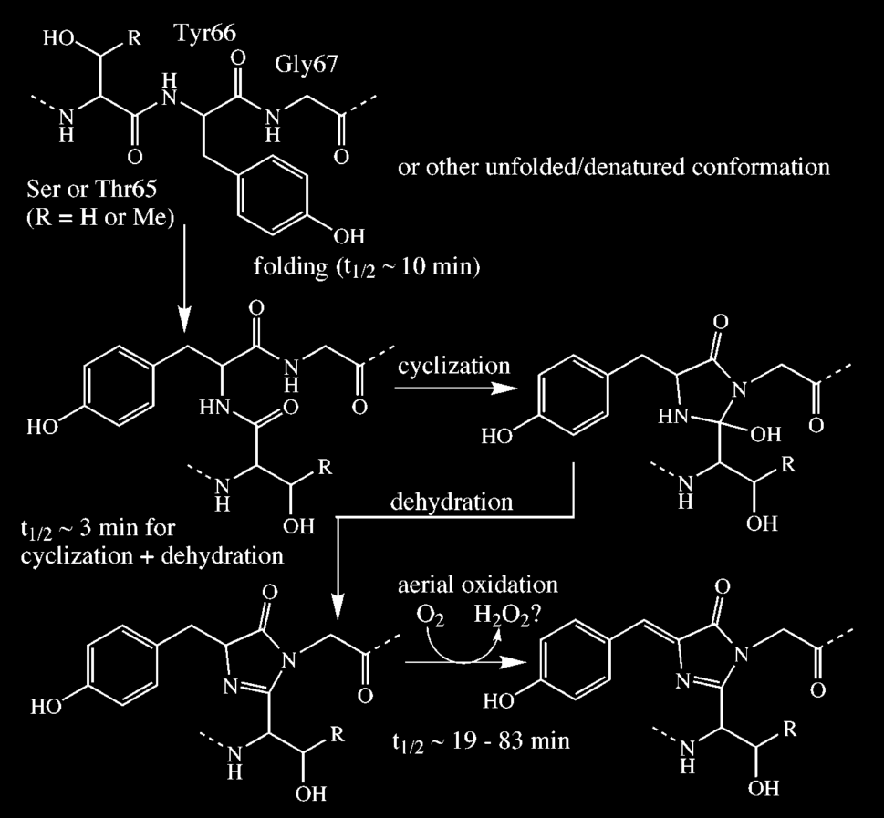
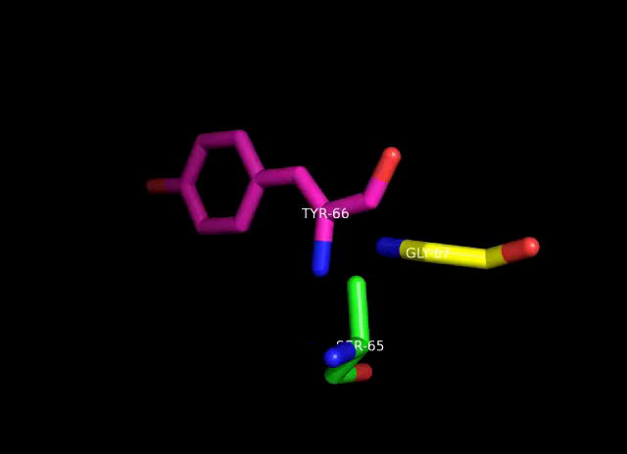
Fluorophore – autocatalytic biosynthesis of GFP fluorophore
Cyclization + oxygenation
(Tsien, 1998)
Notes:
No other enzymes is necessary – autocatalytic
two-step strategy
apart from naturally happened peptide bond,
Oxygen gets in and superoxide comes out
13

Slide 14
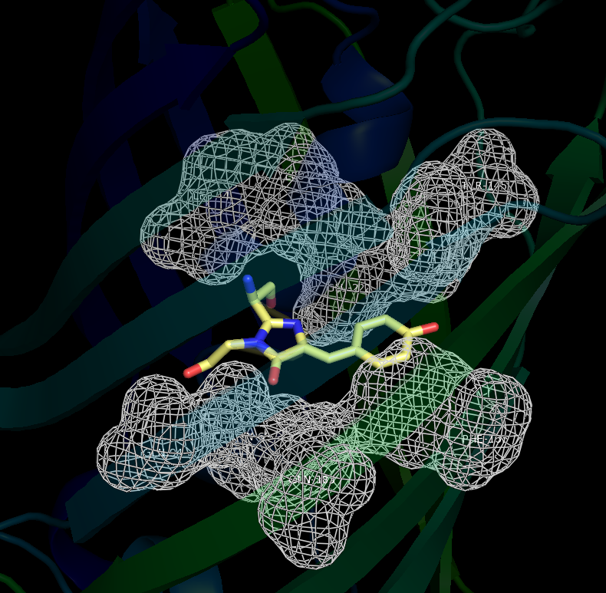
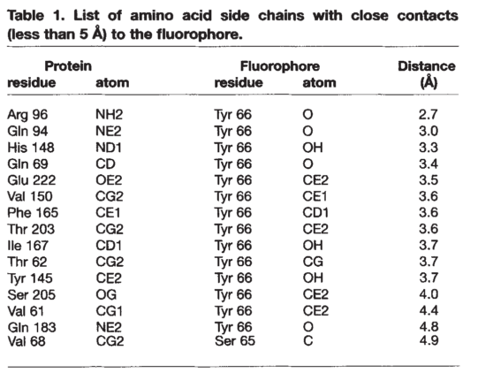
Fluorophore – surrounding residues help with its stabilization
(Yang, Moss, Phillips, Phillips Jr., & Phillips, 1996)
Notes:
highly protected,

Slide 15
Conserved residues in GFP

Slide 16
Chromophores
Surrounding residues
Notes:
16

Slide 17
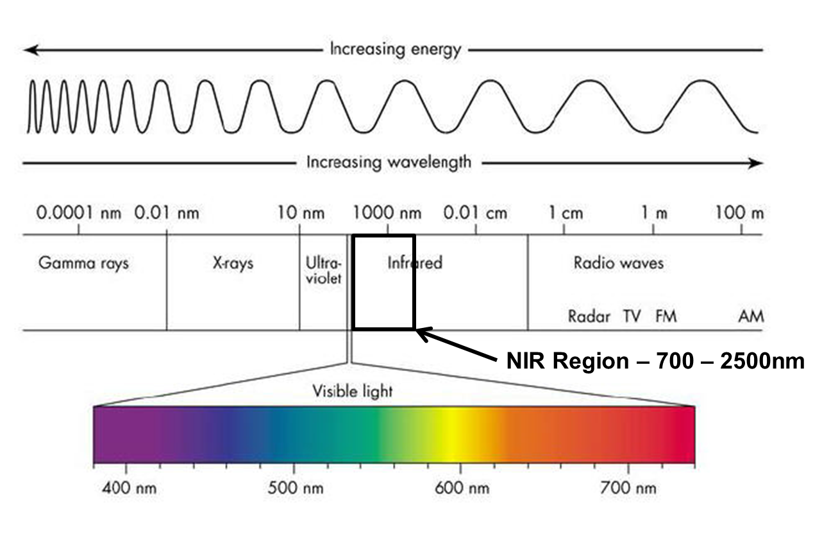
Spectroscopy
Blue-shifted: smaller conjugated π-system
Red-shifted : larger conjugated π-system
(Aromatic compounds)
Phe, Trp, Tyr, His
Notes:
共轭芳环增大，荧光效率增大，荧光峰向长波方向移动
17

Slide 18
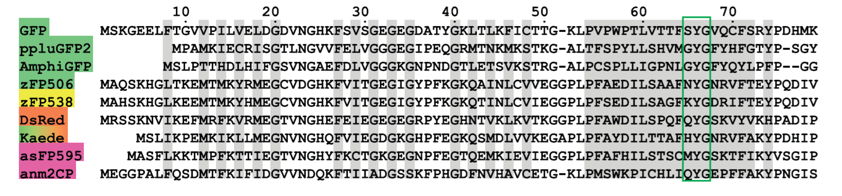
Alignment of selected GFP-like proteins
The first FP characterized, Aequorea victoria wild-type GFP, unusual
Among red-shifted proteins, DsRed-like chromophores are most common
(Chudakov et al., 2010)

Slide 19
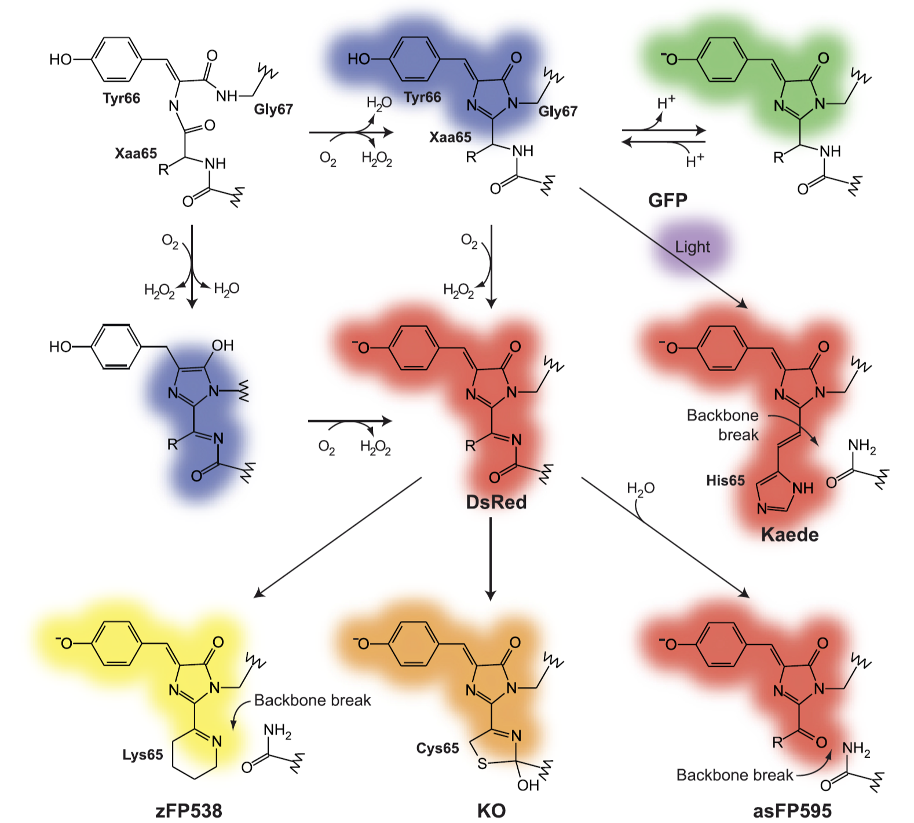
Chemical structures and pathways of maturation of naturally occurring chromophores within GFP-like proteins
(Chudakov et al., 2010)
Notes:
首先，物质只有能够吸收紫外-可见光，才有可能发荧光。因此，发荧光的物质分子中必须含有共轭双键这样的强吸收的基团，且共轭体系越大，π电子的离域性越强，越易被激发而产生荧光。（一般至少含有一个苯环。）共轭芳环增大，荧光效率增大，荧光峰向长波方向移动
一些化学物质能从外界吸收并储存能量（如光能、化学能等）而进入激发态，当其从激发态再回复到基态时，过剩的能量可以电磁辐射的形式放射（即发光）。
19

Slide 20
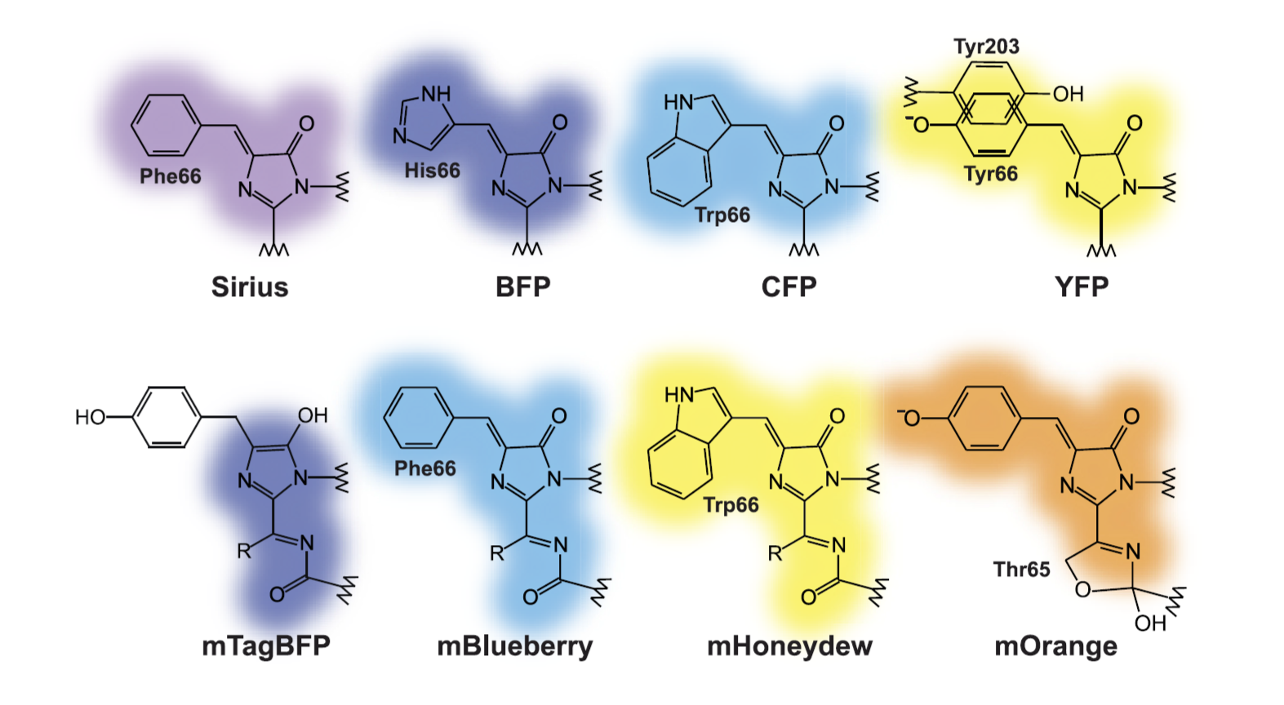
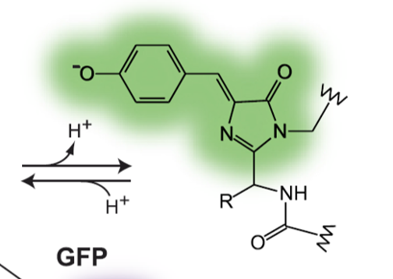
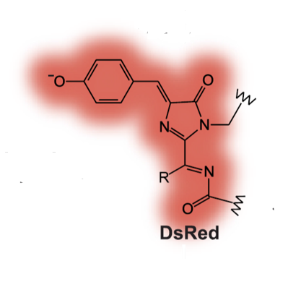
Chemical structures of chromophores obtained in artificially mutated FPs
(Chudakov et al., 2010)
Notes:
cis planar conformation—fluorescent
three-dimensional structures trans nonplanar chromophore-nonfluorescent
20

Slide 21
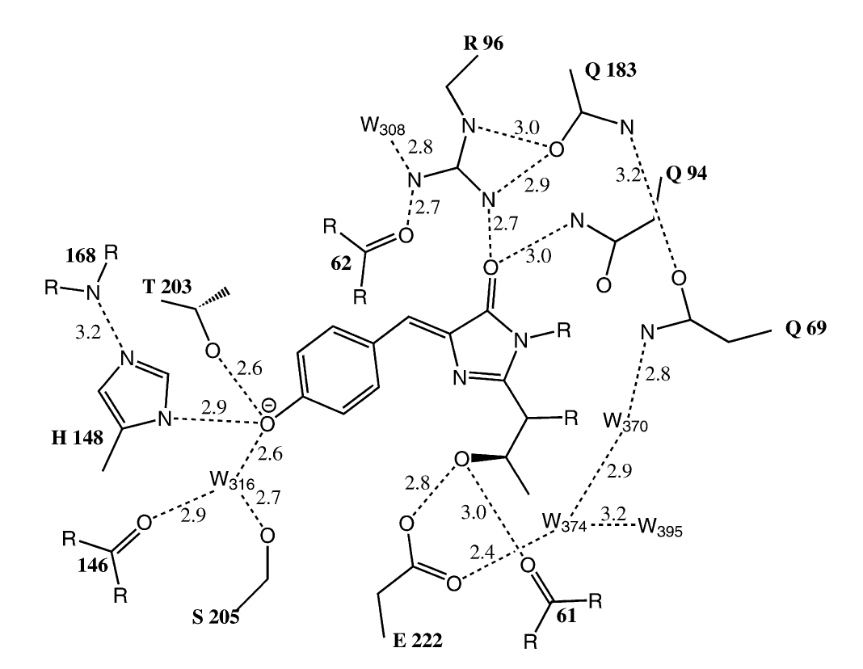
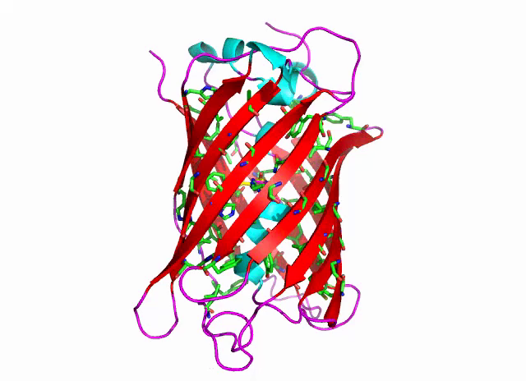
Surrounding residues
(Ormo et al., 1996)
Notes:
21

Slide 22
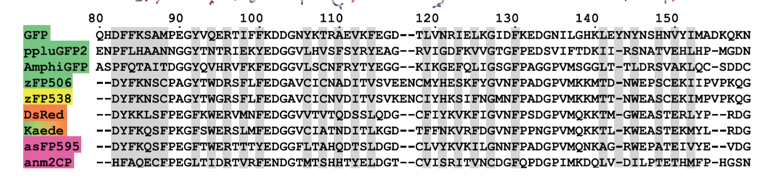
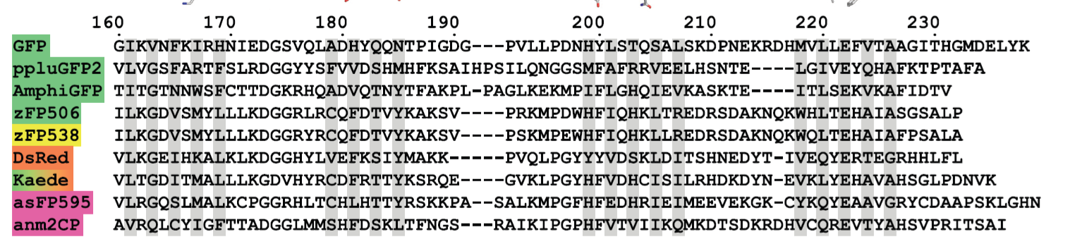
(Chudakov et al., 2010)
Notes:
FIG. 5. Amino acid alignment of selected GFP-like proteins representing different taxa and color classes. GFP from jellyfish Aequorea victoria,
ppluGFP2 from the copepod Pontellina plumata, AmphiGFP from lancelet Branchiostoma floridae, green zFP506 and yellow zFP538 from button
polyp Zoanthus, red FP DsRed from mushroom anemone Discosoma, green-to-red photoconvertible FP Kaede from stony coral Trachyphyllia
geoffroyi, and chromoproteins asFP595 from sea anemone Anemonia sulcata and anm2CP from an unidentified anthomedusa are shown. The
numbering is in accordance with Aequorea victoria GFP. Introduced gaps are represented by dashes. The residues whose side chains form the
interior of the -barrel are shaded. The chromophore-forming triads are highlighted with a green rectangle. The spatial structure and positioning
relative to the chromophore are shown for all -strands and other selected regions above the corresponding amino acid sequences.
22

Slide 23
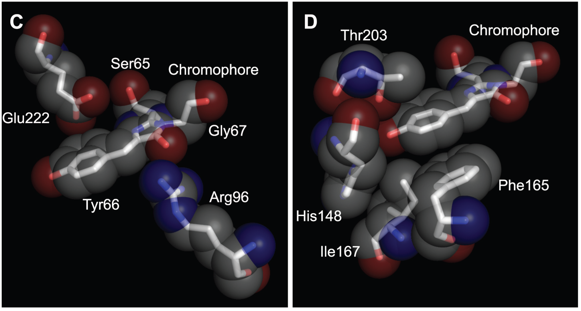
GFP chromophore and selected nearby residues in sticks and semitransparent spacefill representation.
(Chudakov et al., 2010)
Notes:
Arg96 promotes protein backbone cyclization during FP maturation
Side chains of residues 148, 165, 167, and 203 are in contact with Tyr66 of the chromophore
widely used yellow variants of GFP carry a key Thr203Tyr substitution that results in a red-shift of excitation and emission maxima
A bright red FP DsRed was converted into an nonfluorescent chromoprotein state by substitutions Ser148Cys, Ile165Asn, Lys167Met, and Ser203Ala
23

Slide 24
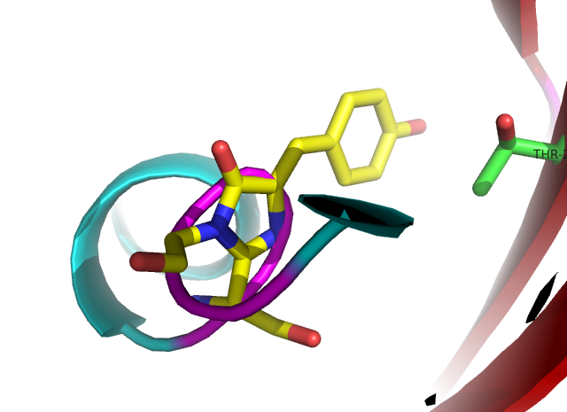
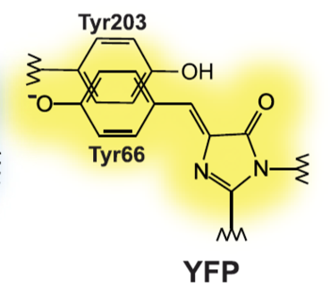
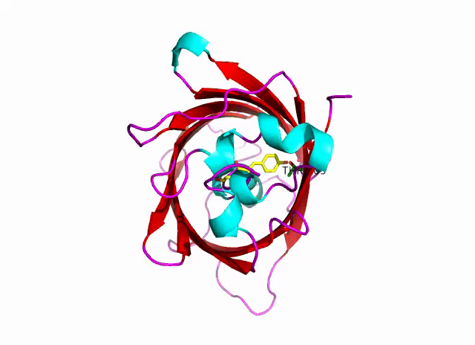
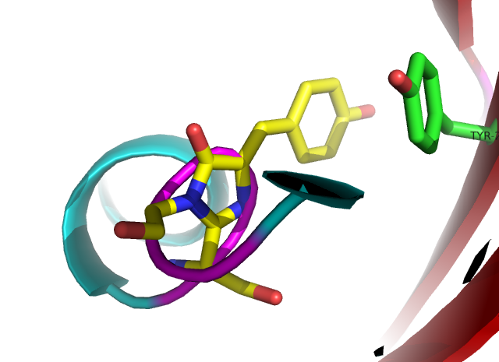
Example
Widely used yellow variants of GFP carry a key Thr203Tyr substitution that results in a red-shift of excitation and emission maxima
(Chudakov et al., 2010)

Slide 25
From new functions to new applications
Fluorescent indicators for Ca2+
based on green fluorescent
proteins and calmodulin ---R.C Tisen
Notes:
25
基于我们对 GFP 结构的理解，我们希望能得到更多在有助于实验的元件．下面我将介绍２大类基于 GFP 的 biosensor.

Slide 26
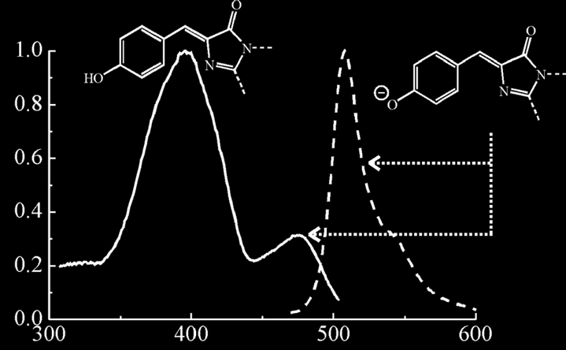
pH sensitiv GFP
(R.C. Tisen, 1998)
Notes:
26
首先

Slide 27
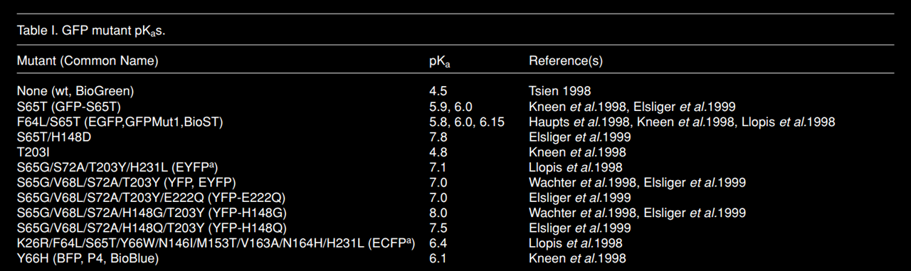
pH sensitive GFP
(Tessa N.Campbell,2001)
Notes:
27
WtGFP 的 pKa 4.5, 说明 wtGFP 适合于偏酸性环境．为了适应更多的实验需求，科学家们对突变了发色基团，以及周围的 amino acids,以得到不同 pKa 的 荧光蛋白．

Slide 28
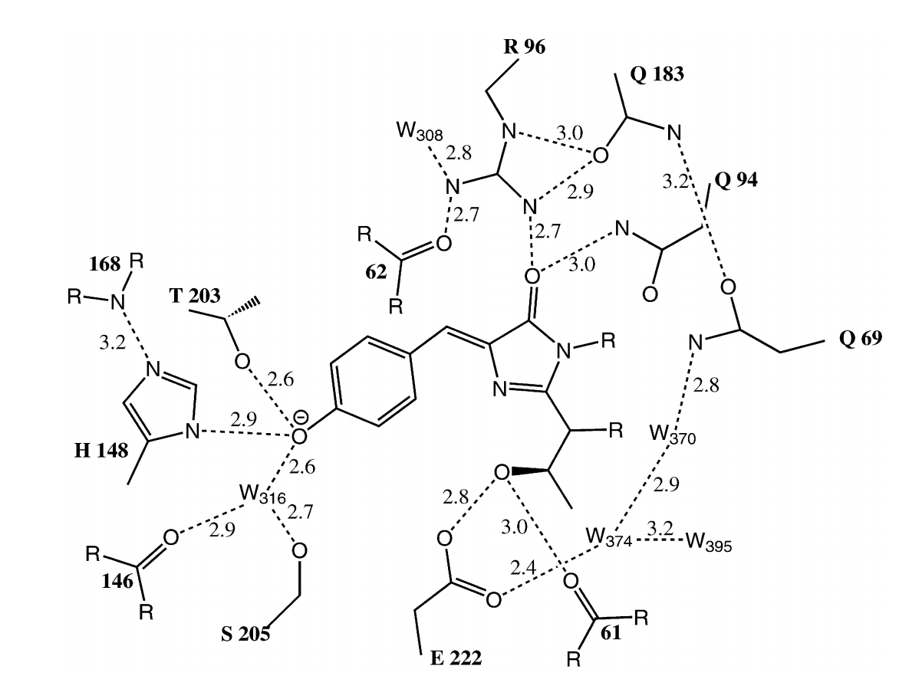
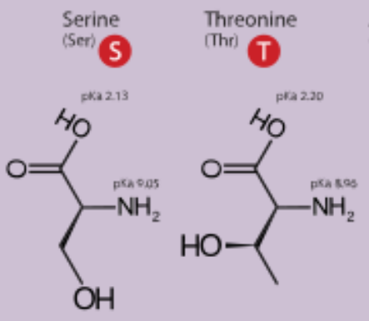
pH sensitive GFP
S65T
(R.C. Tisen, 1998)
Notes:
28
WtGFP 的 pKa 4.5, 说明 wtGFP 适合于偏酸性环境．为了适应更多的实验需求，科学家们对突变了发色基团，以及周围的 amino acids,以得到不同 pKa 的 荧光蛋白．

Slide 29
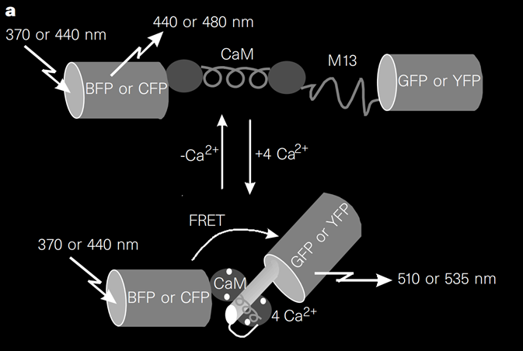
Ca²⁺ Fluorescent Indicator
Fluorescent indicators for Ca2+
based on green fluorescent
proteins and calmodulin ---R.C Tisen
(R.C. Tisen 1997)
Notes:
29
如果我们希望实时检测 in vivo 环境内的钙离子浓度变化，我们可以依次连接 BFP, CaM , M13, GFP．我们把这个组装体叫 Ca2+ fluorescent indicator. 原理如下，BFP 被紫光激发，如果 CaM 没有结合 Ca2+, BFP 的蓝色发射光将发散到环境中，最后显微镜看到的蓝光．但是如果环境中的Ca2+ 与 CaM 结合，整个 Ca2+ fluorescent indicator 构像发生变化，显微镜里将会看到绿光．
这是因为没有 Ca 结合时，CaM 像一个哑铃一样，BFP 与 GFP 之间的距离大于能产生 FRET(荧光共振能量转移) 要求的距离．导致 BFP 发射出的光子能量无法传到 GFP 上，所以末端 GFP 不会受激发出绿光．但 4 个 Ca2+ 结合到 CaM 上时，CaM 构象变化，CaM 两个 Terminal 相互靠近，形成球状，M13 light chain 插入其中．使得 BFP 和 GFP 的 Terminal 靠近．最后 BFP 发射的能量通过 FRET 激发 GFP, 显微镜里会看到绿光．
Fluorescent indicators for Ca2+ based on green fluorescent proteins and calmodulin R.C Tisen
M

Slide 30
Reference
Chudakov, D.M., Matz, M.V., Lukyanov, S., and Lukyanov, K.A. (2010). Fluorescent proteins and their applications in imaging living cells and tissues. Physiological reviews 90, 1103-1163.
Ormo, M., Cubitt, A.B., Kallio, K., Gross, L.A., Tsien, R.Y., and Remington, S.J. (1996). Crystal structure of the Aequorea victoria green fluorescent protein. Science (New York, NY) 273, 1392-1395.
Tsien, R. (1998). the Green Fluorescent Protein. Biochemistry 67, 509–544.
Heim, R., Prasher, D.C., and Tsien, R.Y. (1994). Wavelength mutations and posttranslational autoxidation of green fluorescent protein. Proc. Natl. Acad. Sci. 91, 12501–12504.
Miyawaki, A., Llopis, J., Heim, R., Mccaffery, J.M., Adams, J.A., Ikurak, M., Tsien, R.Y., and Ikura, M. (1997). letters to nature Fluorescent indicators for Ca 2 + based on green fluorescent proteins and calmodulin. Nature 388, 882–887.
Chudakov, D.M., Matz, M. V, Lukyanov, S., and Lukyanov, K.A. (2010). Fluorescent Proteins and Their Applications in Imaging Living Cells and Tissues. Physiol. Rev. 90, 1103–1163.
Han, J., and Burgess, K. (2010). Fluorescent indicators for intracellular pH. Am. Chem. Soc. 110, 2709–2728.
Zhang J, Campbell RE, Ting AY, T.R. (2002). Creating new fluorescent probes for cell biology. Nat. Rev. Mol. Cell Biol. 3, 906–918.
Yang, F., Moss, L.G., Phillips, G.N., Phillips Jr., G.N., and Phillips, G.N. (1996). The molecular structure of green fluorescent protein. Nat. Biotechnol. 14, 1246–1251.
Malo, G.D., Pouwels, L.J., Wang, M., Weichsel, A., Montfort, W.R., Rizzo, M.A., Piston, D.W., and Wachter, R.M. (2007). X-ray structure of Cerulean GFP: A tryptophan-based chromophore useful for fluorescence lifetime imaging. Biochemistry 46, 9865–9873.

Slide 31
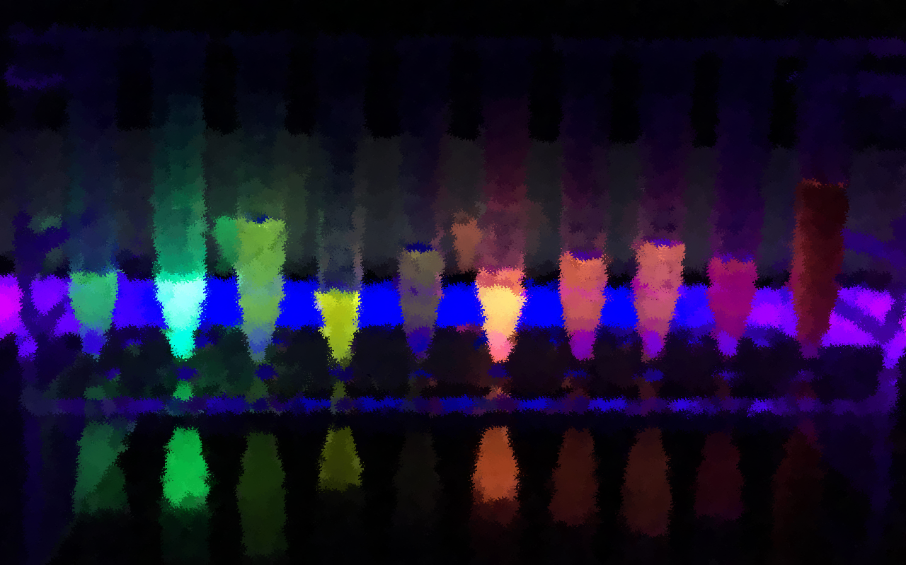
Thank you for listening!

